Slide 1

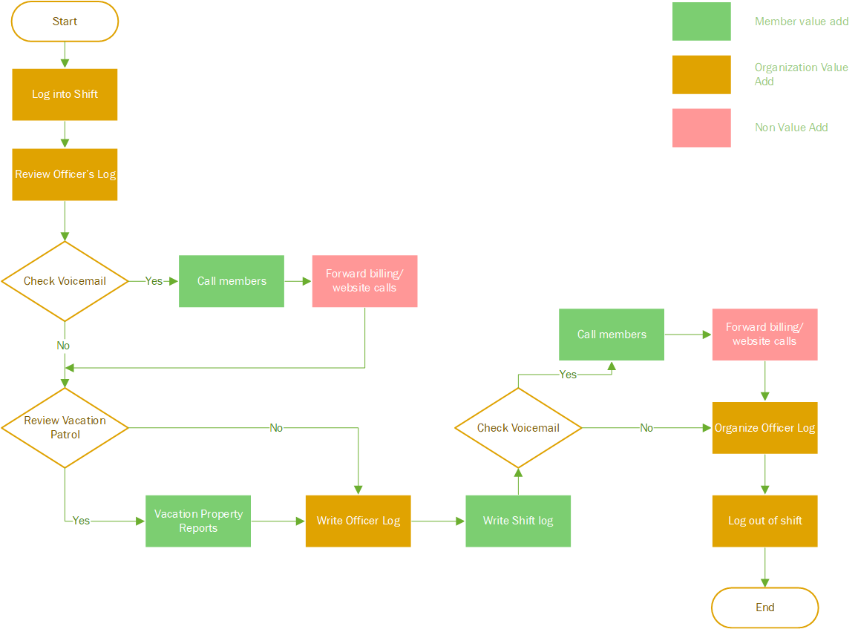


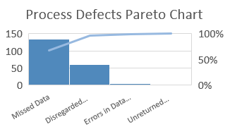
Key Dates
Process Improvement Project: Administrative Time Reduction for Patrol Services
Olga MBC 638
Process Improvement Results
Process Improvement Results
Define by July 23, 2018
Measure by August 6, 2018
Analyze by September 3, 2018
Improve by September 10, 2018
Control by January 1, 2019
DEFINE
MEASURE
ANYLIZE
IMPROVE
Problem Statement:
Forecast for vacation patrol administrative time with seasonality factor:
Lowest predicted vacation patrol count:
February 2018:
Unimproved process: 17.34 + 4.91 = 22.28 min
Improved process: 13.34 + 4.91 = 18.28 min
Highest predicted vacation patrol count:
July 2018:
Unimproved process: 17.34 + 15.07 = 32.41 min
Improved process: 13.34 + 15.07 = 28.41 min
Officers spend in average 30 min each shift performing various administrative duties.
Eliminate repetitive and non value steps
This Photo by Unknown Author is licensed under CC BY
Goal: Decrease administrative time - 10 minutes per shift by implementing IT solution and improving the process.
Remove non value and repeated steps to decrease time spent on admin tasks
SAVINGS = 4 MIN PER SHIFT
10 min reduction = 87 additional street patrol hours per year
Administrative Time (Y)
Fixed administrative time: login and logout of shifts, updating various data logs.
Vacation patrol: time spent on recording vacation property checks.
Membership calls: time spent on answering membership calls.
Impact:
Criminal activity prevention.
Police officer response time to incidents in the covered area.
Membership satisfaction and retention rates.
CONTROL
Vacation Patrol Tasks = number of vacation requests * 1.2 minutes
Implement IT solution (messaging application)
4 min = 35 extra street patrol hours per year
SQL -> 2.8
Fixed Administrative Tasks | Average Vacation Patrol Tasks | TOTAL Average Administrative Time
17.34 min | 12.24 min | 29.58 min

Slide 2
Process Improvement Project: Administrative Time Reduction for Patrol Services
Define
1
Problem Statement:
Increase patrol time
2
3
Goals:
Business Impact:
According to a survey taken by a nonprofit organization offering additional crime prevention services for a specified neighborhood area, 80% of participated members noted that #1 objective is to provide increased street patrol coverage. It has been observed that with continuous increase in criminal activity and during certain hours, response time to incidents may be delayed, in some cases reaching to one hour until a police officer is able to arrive to the scene. By increasing off duty police coverage, immediate police presence and quick response to any incident in the area can be provided.
The project’s goal is to decrease administrative time by 10 minutes per shift. The benefit of improved administrative process equals to 87 additional street patrol hours per year.
The process improvement objectives are:
Improve patrol officer’s work flow to minimize administrative tasks and increase time spent on patrolling streets.
Improve police officer communication capabilities for quicker and more productive response.
Increase in patrol time will provide following benefits to the membership and community:
Membership satisfaction and increase in membership retention.
Decrease in police officer response time to incidents in the covered area.
Decrease in criminal activity.
The project boundaries are limited to decreasing administrative time within pre-determined patrol tasks.

Slide 3

Data Stratification Tree
Define
Questions About Process | X Variables | Measurements
How much time is spent on fixed administrative tasks? | Fixed administrative time | Time in minutes
How much time is spent on vacation patrol administrative tasks (logging vacation patrol reports)? | Time spent on vacation patrol tasks | Time in minutes
How many vacation patrols per year? | Vacation patrols per year | Number of vacation patrols per year
Is vacation patrol vary by time of the year? | Vacation patrols per month | Number of individual vacation patrols per month
*How many calls per year? | Number of calls | Number of calls per year
*Do calls vary by time of the year? | Calls per month | Number of calls per month
Administrative Time (Y)
Fixed administrative time: login and logout of shifts, updating various data logs.
Vacation patrol: time spent on recording vacation property checks.
*Membership calls: time spent on responding to membership calls.
Low Impact
Fixed
High Impact
Varies
High Impact
Varies
Discrete Data: number of phone calls, number of vacation patrols.
Continuous Data: various administrative tasks measured in minutes.
Data Collection: Data is obtained from company’s database records.
Data Measurement: Historical data is automatically logged/recorded from iPhone application and website activities from 2010 to present time.
Data Stratification Tree / y=f(x)
* Analysis of membership calls is outside of scope of the project.

Slide 4
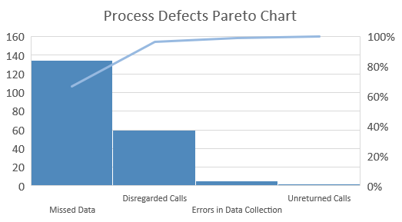
Define
Root Cause Evaluation Chart
Problem/error | Possible Cause | Probability | Measurable? Data Collection Method
Missing data | Forgot to enter shift, vacation and other information | high | Yes, obtained from database logs
Errors in data collection | Human errors, mistakes in entering data | low | Yes, obtained from database logs
Unreturned membership calls | Forgot to return call | low | Yes, interview with officers
Disregarded follow up calls | Determined as “no return” calls by an officer due to time and call relevancy | high | Yes, interview with officers
SQL Calculation Summary
Shifts per year U=594
Calculated as average count of shifts for the last three years (2015-2017).
Actual Defects per year A=202
Errors in data collection– 5 Calculated as average count of double entries for the 2015-2017.
Missing vacation data– 135 Calculated as count of unique Date records for 2015-2017. Excel:=SUMPRODUCT(1/COUNTIF(E2:E7829,E2:E7829)) = 691 days. Total number of days (2015-2017): 365*3 = 1095. Days (missing records) per year= (1095-691)/3= 135
Unreturned membership calls– 2
Disregarded calls – 60
Phone calls data is obtained by interviews with officers.
Sigma Quality Level:
Defects: D=4
Shifts per Year: U=594 -> D*U = 2376 Total actual defects: A=202
DPO= 202/2376=0.08501, Per million: 85017
SQL= 2.8

Slide 5
Measure
Process Step | Time/Min
Shift Login | 0.42
Review officer log | 1
Voicemail
Return calls | Varies
Forward unrelated calls | 2
Review vacation list | 0.5
Patrol property
Vacation report | Varies 1.2 min per home
Officer Log | 5
Shift Log | 3
Voicemail
Return calls | Varies
Forward unrelated calls | 2
Organize officer log (notes, receipts) | 3
Shift log out | 0.42
Flow Chart of the Process
Eliminate repetitive
and non value steps.
Total low impact: 17.34 min, including non value: 4 min

Slide 6
Measure
Measure Administrative Time
Summary
Data summary: Administrative time spent on vacation patrol tasks, based on vacation patrol data recorded in 2017.
Data type: Continuous
Tools: Measures of Central Tendency, Measures of Dispersion
Goal: Obtain measures of central tendency and dispersion for vacation patrol administrative tasks.
Vacation Patrol Tasks = number of vacation patrols per shift * 1.2 minutes
Measures of Central Tendency
 | # Vacation patrols (X) |  | X *1.2 (min)
Mean | 10.20 |  | 12.24382
Median | 9.00 |  | 10.8
Mode | 8.00 |  | 9.6
Measures of Dispersion
Standard Deviation | 6.34 | 6.34 | 7.605565
Min | 1.00 | 1.00 | 1.2
Max | 29.00 | 29.00 | 34.8
Quartile, 25th percentile | 6.00 | 6.00 | 7.2
Quartile, 50th percentile | 9.00 | 9.00 | 10.8
Quartile, 75th percentile | 14.00 | 14.00 | 16.8
Sample Size Calculation
Calculate sample size with 95% of confidence level and E(margin of error) =1 min (sample mean is within 1 min of population mean).
Formula: n= (Z*(Standard Deviation)/E)^2.
Z (95% confidence level) = 1.96. n=(1.96(7.61)/1)^2=223
Average Administrative Time is 30 minutes per shift
Data Stratification Tree / y=f(x)
Fixed Administrative Tasks, min | Average Vacation Patrol Tasks, min | TOTAL Administrative Time
17.34 | 12.24 | 29.58

Slide 7

Analyze
Vacation Patrol Tasks = number of vacation patrols per shift * 1.2 minutes
Time Series Analysis for Vacation Patrol Data
Analysis Summary
Data summary: Observed count of vacation patrols for 2012-2017.
Data type: Discrete
Tools: Time series analysis with Exponential Smoothing model, Time Plot.
Goal: Forecast vacation patrols data for 2018.
Time Plot is created to visualize changes in number of vacation patrols performed by officers over 6 year period (2012-2017). Exponential smoothing model is used to forecast 2018 number of vacation patrols using various smoothing factors.
Year | # Patrols | df=0.2 | df=0.8
2012 | 2454 | #N/A | #N/A
2013 | 2165 | 2454 | 2454
2014 | 2241 | 2222.8 | 2396.2
2015 | 2250 | 2237.36 | 2365.16
2016 | 3330 | 2247.472 | 2342.128
2017 | 2247 | 3113.494 | 2539.702
2018 |  | 2420.299 | 2481.162

Slide 8
Analyze
Time Series Analysis for Vacation Patrol Data
Vacation Patrol Count and Time of Year Histogram
Control Charts for average monthly vacation patrol count
Compute the Natural Process Limits for the X chart
UNPL=Xbar + (2.66*mRbar) | 352
LNPL=Xbar - (2.66*mRbar) | 52
Compute the Upper Range Limit
URL=3.27*mRbar | 184
Histogram chart of vacation patrol data for 6 year period displays systematic pattern of increase in number of vacation patrols during summer months.
Process Control Chart shows drastic increase in number of vacation patrols in the month of July.
Analysis Summary
Data summary: Observed count of vacation patrols for 2012-2017. Average count of vacation patrols each month.
Data type: Discrete
Tools: Histogram, Control Chart.
Goal: Analyze seasonality for vacation patrols data.

Slide 9
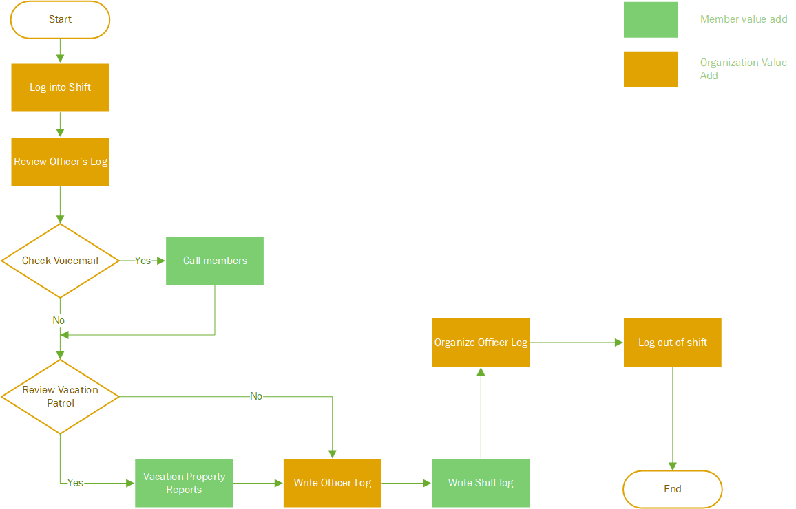
Improve
Improve Administrative Time Process
Flow Chart of Improved Process
Process Improvement Summary
Phone Response tasks:
In order to improve the administrative time process it is recommended to outsource phone calls/voicemail tasks. Crime related calls should be forwarded for response during each shift.
Implementation of messaging system is recommended to improve SQL. Messaging solution will allow officers to respond to membership requests quickly, spending only few seconds to send each message. Messaging solution will drastically lower or eliminate “disregarded calls” defect.
Administrative call/messaging time should be measured and analyzed after improvement implementation and during control stage.
Remove non value and repeated steps to lower time spent on administrative tasks
SAVINGS = 4 MIN PER SHIFT

Slide 10
Improve
Process Improvement Hypothesis Test
Hypothesis Test Summary
Hypothesis test is performed to determine if administrative tasks process improvements are statistically significant.
Ho: μ = μ0, μ = 16.24
Ha: μ < μ0, μ < 16.24
Chart type: One tail for Continuous data.
Sample size: Test statistics for Z formula requires sample size >=30. Actual sample size for 2017 vacation patrol data: n=251.
Formula: Z = x bar – μ0 / (s/sqrt(n))
Z Calculation
Z=12.24-16.24/(7.61/sqrt(251)) = -8.33333
P Calculation (Excel)
P= NORM.S.DIST(-8.33,TRUE) ~ 0
Alpha (level of confidence)
α = 0.05 (Confidence = 95%), P< α Ho must go.
Summary: Hypothesis test has confirmed that administrative time process improvement was statistically significant.
Process Improvement Summary
Fixed Administrative tasks:
Removed non value steps: Savings = 4 min.
Hypothesis test is performed to determine statistical significance of the process improvement.
Vacation Patrol Tasks
Descriptive statistics analysis was performed to measure central tendency and dispersion of vacation patrol data.
Time series analysis was performed to forecast vacation patrol data.
Seasonality factor was calculated for each month of the year to forecast number of vacation patrols. Definite spike in vacation patrols during summer months is observed.
Null hypothesis: Officers spend 16.24 min on vacation patrol tasks.
Alternative hypothesis: Officers spend less than 16.24 min
on vacation patrol tasks.

Slide 11
Improve
Improve Administrative Time Process
Forecast with Seasonality Factor
Process Improvement Summary
Vacation Patrol tasks:
Seasonality factor is detrimental in estimating administrative time during various months of the year.
 |  |  | Forecast 2018
Month | Y | SF = Y/Pr Y | VP per shift * SF (rounded) | Time, min*
Jan | 173 | 0.85490734 | 6 | 6.976044
Feb | 122 | 0.60123542 | 4 | 4.906081
Mar | 150 | 0.73877831 | 5 | 6.028431
Apr | 170 | 0.84172958 | 6 | 6.868513
May | 185 | 0.91256005 | 6 | 7.44649
Jun | 244 | 1.20411805 | 8 | 9.825603
Jul | 374 | 1.84653397 | 13 | 15.06772
Aug | 288 | 1.42402196 | 10 | 11.62002
Sep | 202 | 0.99821551 | 7 | 8.145439
Oct | 136 | 0.67206589 | 5 | 5.484058
Nov | 171 | 0.84420041 | 6 | 6.888675
Dec | 215 | 1.06163349 | 7 | 8.662929
Predicted Y | 202
Seasonality Factor (SF) Calculation
Forecast for vacation patrol administrative time:
Lowest predicted vacation patrol count:
February 2018:
Unimproved process: 17.34 + 4.91 = 22.28 min
Improved process: 13.34 + 4.91 = 18.28 min
Highest predicted vacation patrol count:
July 2018:
Unimproved process: 17.34 + 15.07 = 32.41 min
Improved process: 13.34 + 15.07 = 28.41 min
Data Stratification Tree / y=f(x)
2018 Forecast is based on Exponential Smoothing Model with df=0.8
* Time (min) – estimated number of vacation patrols * 1.2

Slide 12
Control
Control Summary
Implement administrative tasks process changes by removing non value steps.
Implement new IT solution for Phone response tasks by outsourcing phone/voicemail services and upgrading to messaging application.
Establish monitoring and measurement system for phone/messaging tasks.
Forecast and monitor vacation patrol data depending on seasonality factors. Implement additional monitoring during spikes in vacation patrols.
Recalculate SQL after reasonable monitoring time.
4 min = 35 extra street patrol hours per year

